Slide 1
Object Detection Mobile App for Visually Impaired

Slide 2
Applications of Computer Vision
1. Data Centers
Social Media Analysis
Govt. Intelligence
2. Gadgets
Self Driving cars
Smart phones
Drones

Slide 3
Applications of Computer Vision
1. Data Centers
Social Media Analysis
Govt. Intelligence
2. Gadgets
Self Driving cars
Smart phones
Drones
Low Power is required !!
Real time is required !!

Slide 4


Major Objectives
Object detection with a sufficiently high accuracy
Decreasing the size and power consumption
Calculating the distance from the object

Slide 5
Evaluation metrics:
Accuracy
Number of parameters
Size of the model

Slide 6
Current models
Year | Model | Top 1% accuracy | # Parameters
2012 | Alexnet | 57% | 62,378,344
2014 | GoogleLeNet | 68% | 102,897,440
2014 | VGG-16 | 71% | 138,357,544
2015 | ResNet-50 | 75% | 25,636,712
2016 | Inception-v3 | 78% | 23,851,784

Slide 7
Problem at hand
Reduce the number of parameters keeping a decent accuracy
Because…
# Parameters ∝ Size of the model ∝ Power consumption

Slide 8
A Regular CNN

Slide 9
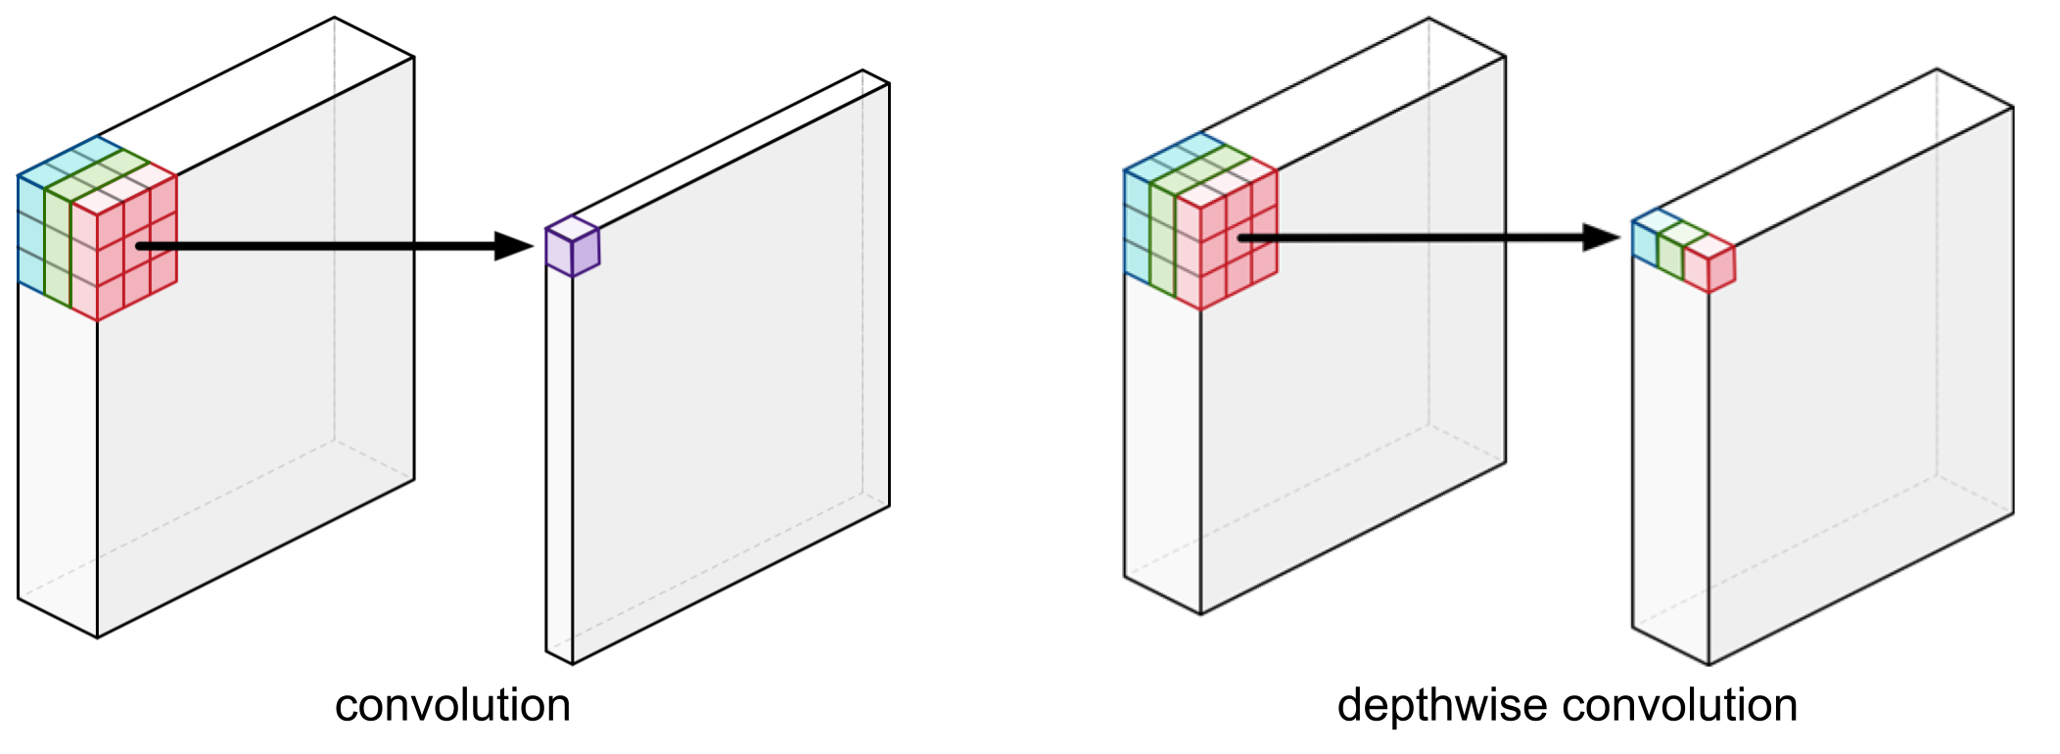
Our Approach
Depth-wise Convolution (Xception: Deep Learning with Depthwise Separable Convolutions)
Notes:
Instead of applying filters to all the channels, it applied filter to some of the channels. Usually doesn’t kill the accuracy.

Slide 10
Why do this?
A regular convolution has to do much more computational work to get there and needs to learn more weights.
Depth-wise Separable Convolution is about 9 times as fast as the regular convolution!

Slide 11
Initial model’s demo
Top-1% Accuracy = 70.6%
Number of parameters = 4,253,864
FPS = ?

Slide 12
Can we make it even better?

Slide 13
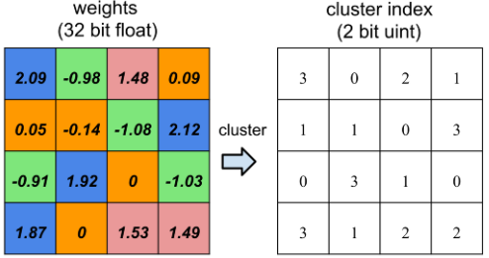
Things we looked at:
Quantization (Fixed Point Quantization of Deep Convolutional Networks)

Slide 14
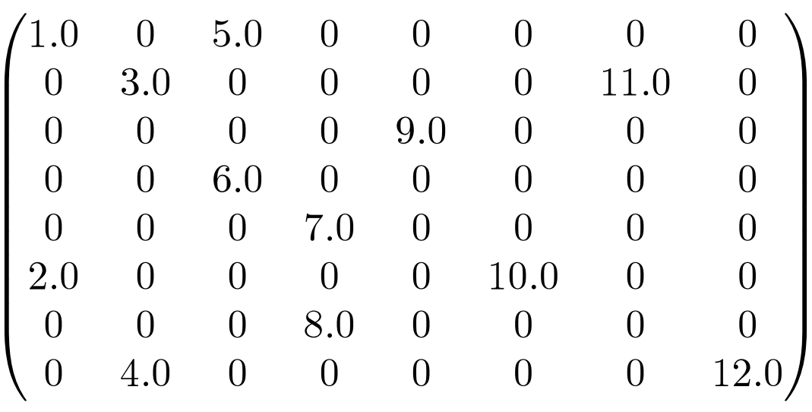
Things we looked at:
Setting low weights to ZERO (Two-Bit Networks for Deep Learning on Resource-Constrained Embedded Devices)
Notes:
Unfortunately, GPUs aren’t great at working with sparse matrices and you may lose more in computation time than you gained by shrinking the network. In this case, smaller does not necessarily mean faster. creates an additional storage overhead

Slide 15
Other techniques
Most Pruning techniques try to remove parameters from the fully connected layers because of its density.
But…
The fully connected layers of VGG-16 occupy 90% of the total parameters but only contribute less than 1% of the overall floating point operations (FLOP).

Slide 16
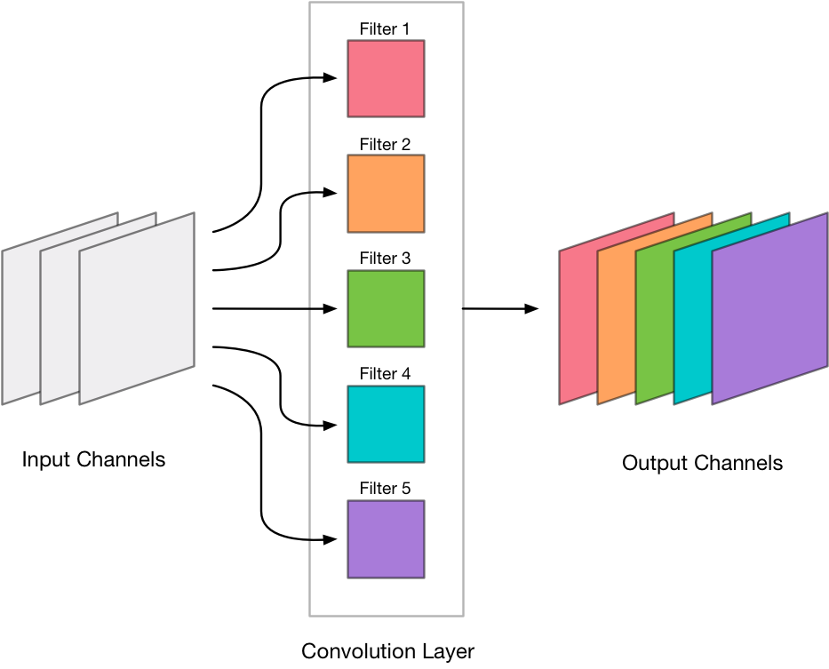
Our Solution
Filter Pruning (PRUNING FILTERS FOR EFFICIENT CONVNETS )

Slide 17
Issues
Depth-wise layer cannot be reduced using filter pruning
Computational and Storage issues for using image-net data (300 GB)

Slide 18
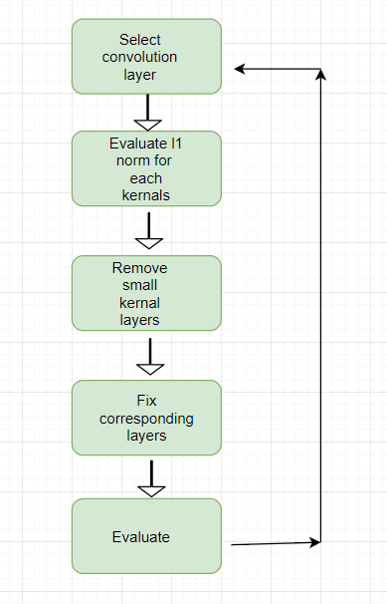
Workflow

Slide 19
Convolution Layers
Layer (type) | Original Output Shape | Original Params | Pruned Output Shape | Pruned Params
conv1 (Conv2D) | (, 112, 112, 32) | 864 | (, 112, 112, 32) | 0
conv_pw_1 (Conv2D) | (, 112, 112, 64) | 2048 | (, 112, 112, 64) | 0
conv_pw_2 (Conv2D) | (, 56, 56, 128) | 8192 | (, 56, 56, 128) | 0
conv_pw_3 (Conv2D) | (, 56, 56, 128) | 16384 | (, 56, 56, 128) | 0
conv_pw_4 (Conv2D) | (, 28, 28, 256) | 32768 | (, 28, 28, 256) | 0
conv_pw_5 (Conv2D) | (, 28, 28, 256) | 65536 | (, 28, 28, 256) | 0
conv_pw_6 (Conv2D) | (, 14, 14, 512) | 131072 | (, 14, 14, 512) | 0
conv_pw_7 (Conv2D) | (, 14, 14, 512) | 262144 | (, 14, 14, 512) | 0
conv_pw_8 (Conv2D) | (, 14, 14, 512) | 262144 | (, 14, 14, 512) | 0
conv_pw_9 (Conv2D) | (, 14, 14, 512) | 262144 | (, 14, 14, 512) | 0
conv_pw_10 (Conv2D) | (, 14, 14, 512) | 262144 | (, 14, 14, 512) | 0
conv_pw_11 (Conv2D) | (, 14, 14, 512) | 262144 | (, 14, 14, 512) | 0
conv_pw_12 (Conv2D) | (, 7, 7, 1024) | 524288 | (, 7, 7, 1024) | 0
conv_pw_13 (Conv2D) | (, 7, 7, 1024) | 1048576 | (, 7, 7, 704) | 400,256

Slide 20
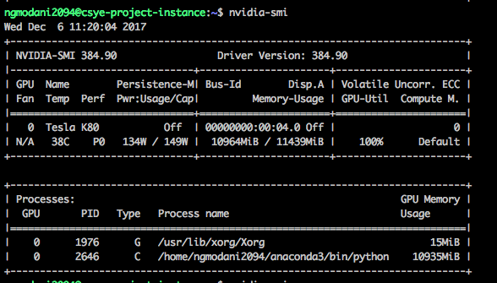
Hardware
Google Cloud Platform
8 Core CPU, 30 GB Memory
1 NVIDIA Tesla K80 GPU

Slide 21
Code & Demo

Slide 22
Result
 | Original model | Pruned model (only last layer)
Accuracy | 70.6 | 68.12
No of parameters | 4,253,864 | 3,583,656 (84% of the original)
FPS | 0 to 1 | 10 to 15

Slide 23
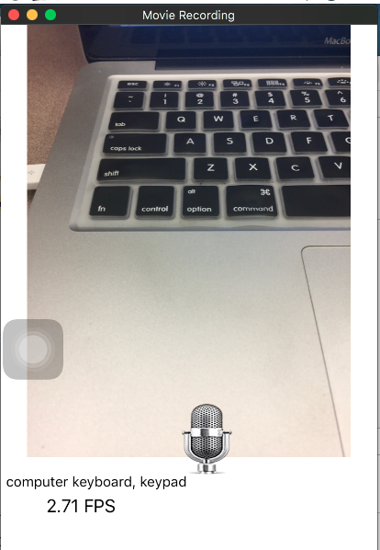
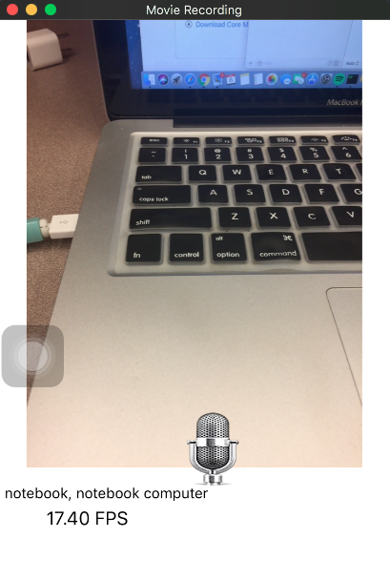

Slide 24
Questions?

